Slide 1
INTERACTION STYLES

Slide 2
Intro
Interaction can be seen as a dialog between the computer and the user. The choice of interface style can have a profound effect on the nature of this dialog.
There are a number of common interface styles including
command line interface
menus
natural language
question/answer and query dialog
form-fills and spreadsheets
WIMP
point and click
Three-dimensional interfaces.

Slide 3
Command line interface
The command line interface was the first interactive dialog style to be commonly used and, in spite of the availability of menu-driven interfaces, it is still widely used.
It provides a means of expressing instructions to the computer directly, using function keys, single characters, abbreviations or whole-word commands.
In some systems the command line is the only way of communicating with the system, especially for remote access using telnet.

Slide 4
Menu-based interfaces, providing accelerated access to the system‘s functionality for experienced users.
Command line interfaces are powerful in that they offer direct access to system functionality and can be combined to apply a number of tools to the same data.
They are also flexible: the command often has a number of options or parameters that will vary its behavior in some way, and it can be applied to many objects at once, making it useful for repetitive tasks.
Flexibility and power brings with it difficulty in use and learning.

Slide 5
Commands must be remembered, as no cue is provided in the command line to indicate which command is needed.
They are therefore better for expert users than for novices. This problem can be alleviated a little by using consistent and meaningful commands and abbreviations.
The commands used should be terms within the vocabulary of the user rather than the technician.
Unfortunately, commands are often obscure and vary across systems, causing confusion to the user and increasing the overhead of learning.

Slide 6
Menus
In a menu-driven interface, the set of options available to the user is displayed on the screen, and selected using the mouse, or numeric or alphabetic keys.
Since the options are visible they are less demanding of the user, relying on recognition rather than recall.
Menu options still need to be meaningful and logically grouped to aid recognition.
Often menus are hierarchically ordered and the option required is not available at the top layer of the hierarchy.

Slide 7
The grouping and naming of menu options then provides the only cue for the user to find the required option.
Such systems either can be purely text based, with the menu options being presented as numbered choices, or may have a graphical component in which the menu appears within a rectangular box and choices are made, perhaps by typing the initial letter of the desired selection, or by entering the associated number, or by moving around the menu with the arrow keys.

Slide 8
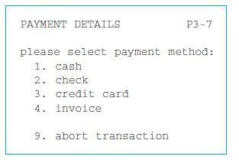
Figure Menu-driven interface

Slide 9
Natural language
Users, unable to remember a command or lost in a hierarchy of menus, may long for the computer that is able to understand instructions expressed in everyday words!
Natural language understanding, both of speech and written input, is the subject of much interest and research. The ambiguity of natural language makes it very difficult for a machine to understand.
Language is ambiguous at a number of levels. First, the syntax, or structure, of a phrase may not be clear.

Slide 10
Question/answer and query dialog
Question and answer dialog is a simple mechanism for providing input to an application in a specific domain.
The user is asked a series of questions (mainly with yes/no responses, multiple choice, or codes) and so is led through the interaction step by step These interfaces are easy to learn and use, but are limited in functionality and power.
As such, they are appropriate for restricted domains (particularly information systems) and for novice or casual users.

Slide 11
Form-fills and spreadsheets
Form-filling interfaces are used primarily for data entry but can also be useful in data retrieval applications.
The user is presented with a display resembling a paper form, with slots to fill in .Often the form display is based upon an actual form with which the user is familiar, which makes the interface easier to use.
The user works through the form, filling in appropriate values. The data are then entered into the application in the correct place.
Most form-filling interfaces allow easy movement around the form and allow some fields to be left blank.

Slide 12
They also require correction facilities, as users may change their minds or make a mistake about the value that belongs in each field.
The dialog style is useful primarily for data entry applications and, as it is easy to learn and use, for novice users.
Spreadsheets are a sophisticated variation of form filling. The spreadsheet comprises a grid of cells, each of which can contain a value or a formula.
The formula can involve the values of other cells (for example, the total of all cells in this column).

Slide 13
The user can enter and alter values and formulae in any order and the system will maintain consistency amongst the values displayed, ensuring that all formulae are obeyed.
The user can therefore manipulate values to see the effects of changing different parameters.
Spreadsheets are an attractive medium for interaction: the user is free to manipulate values at will and the distinction between input and output is blurred, making the interface more flexible and natural.

Slide 14
WIMP Interface
WIMP stands for windows, icons, menus and pointers (sometimes windows, icons, mice and pull-down menus), and is the default interface style for the majority of interactive computer systems in use today, especially in the PC and desktop workstation arena.
Examples of WIMP interfaces include Microsoft Windows for IBM PC compatibles, MacOS for Apple Macintosh compatibles and various X Windows-based systems for UNIX.

Slide 15
Point-and-click interfaces
This point-and-click interface style is obviously closely related to the WIMP style.
It clearly overlaps in the use of buttons, but may also include other WIMP elements. The philosophy is simpler and more closely tied to ideas of hypertext.
In addition, the point-and click style is not tied to mouse-based interfaces, and is also extensively used in touchscreen information systems.
In this case, it is often combined with a menu-driven interface.
The point-and-click style has been popularized by world wide web pages, which incorporate all the above types of point-and-click navigation: highlighted words, maps and iconic buttons.

Slide 16
Three-dimensional interfaces
There is an increasing use of three-dimensional effects in user interfaces. The most obvious example is virtual reality, but VR is only part of a range of 3D techniques available to the interface designer.
The simplest technique is where ordinary WIMP elements, buttons, scroll bars, etc., are given a 3D appearance using shading, giving the appearance of being sculpted out of stone.
By unstated convention, such interfaces have a light source at their top right. Where used judiciously, the raised areas are easily identifiable and can be used to highlight active areas.

Slide 17
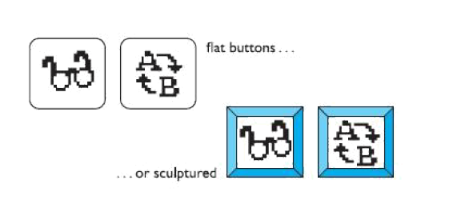
some interfaces make indiscriminate use of sculptural effects, on every text area, border and menu, so all sense of differentiation is lost.

